Slide 1

Report of one day State Level Webinar organised by the Department of Computer Application in association with IQAC, Santipur College held on 27th June, 2025 from 03.00PM to 05.00 PM
JULY 12, 2025
Department of Computer Application
Santipur College
1

Slide 2

Webinar Report
An One day State Level Webinar on "Empowering Education: Practical & Impactful application of AI tools for student" successfully organized by the Department of Computer Application in association of IQAC, Santipur College on 27th June, 2025 from 03.00 PM onwards. In the session Prof. Ujjal Kumar Das, Assistant Professor, Department of Computer Science, HOD, Bagula College, University of Kalyani, Kalyani, our Resource person delivered his lecture on the topic Sustainable Development Goals and Role of AI in life. It is important to mention that 114 participants consisting faculty members, Research Scholars, Independent Researchers, Postgraduate and Undergraduate students and others from different Universities, Institutes and Colleges of different parts of the country actively participated in the webinar. At the end of the lectures under the interactive session of question answer, active participation was witnessed. The sub topics discussed in the webinar enrich the knowledge resources not only to the participants of "Computer Application” background but also effective for the entire learners from any subjects. After attending the webinar undergraduate students (both major and minor) relate the textual concepts with the practical applications that will surely benefit in sustainable development of the academic activities at present and in near future also.

Slide 3
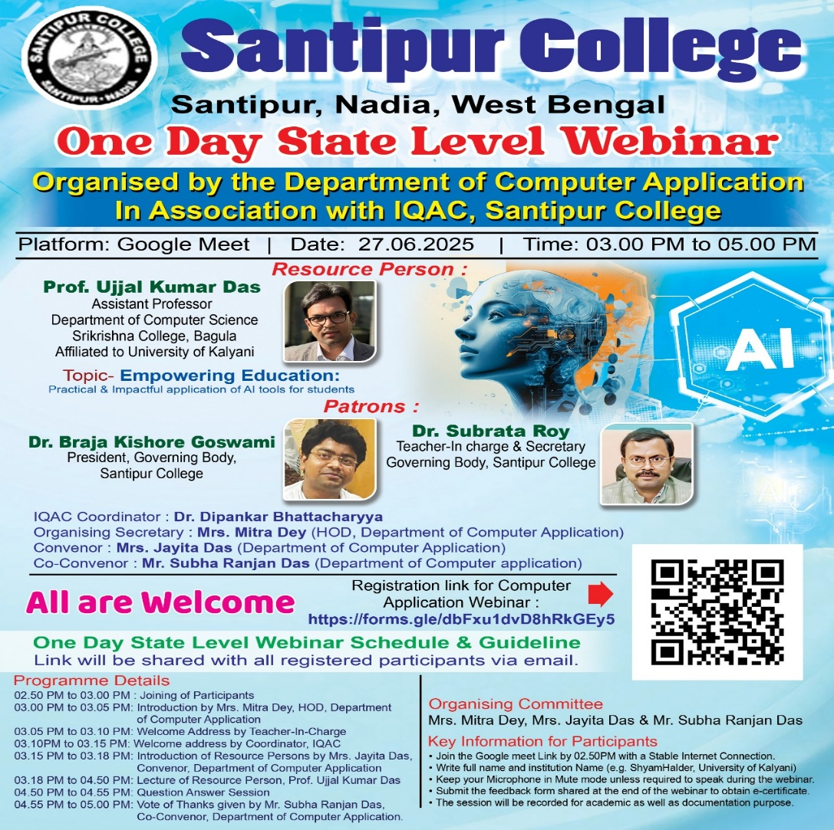

Slide 4
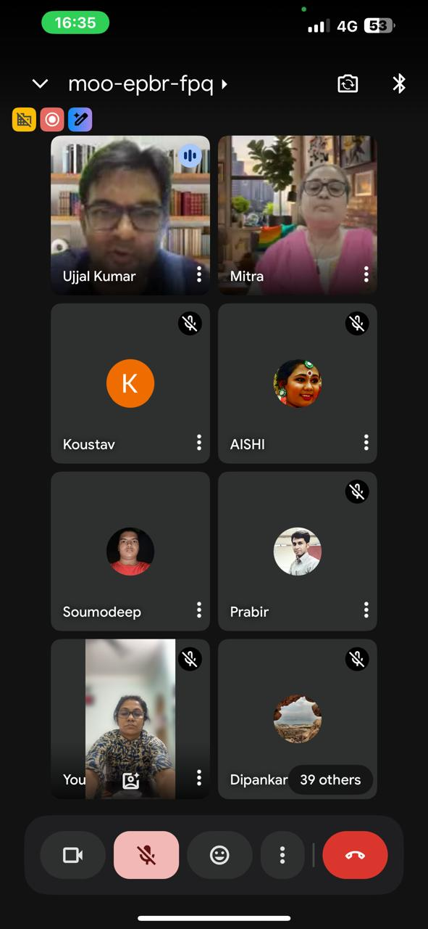
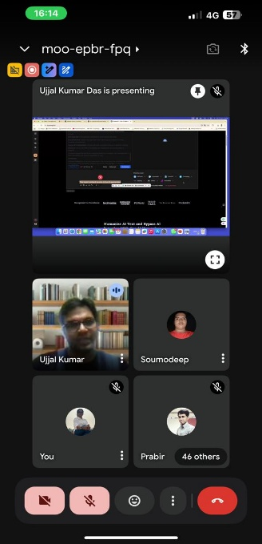
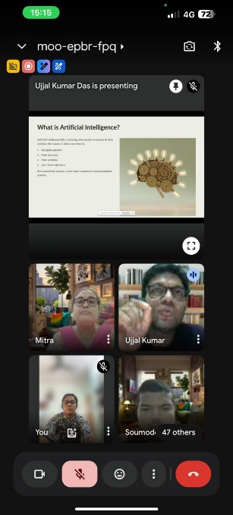
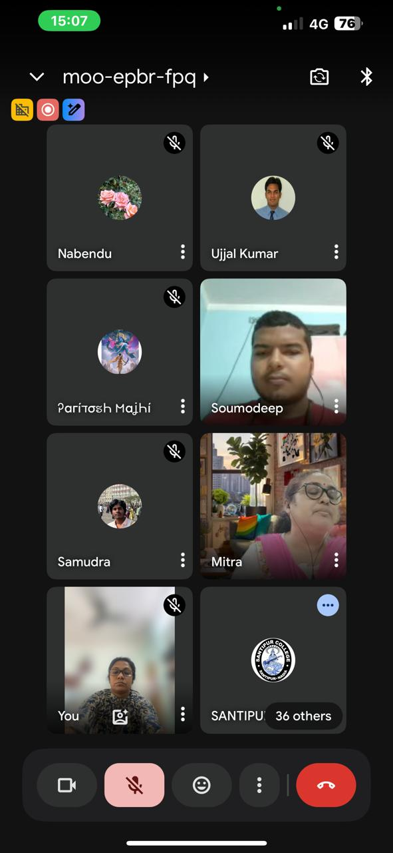
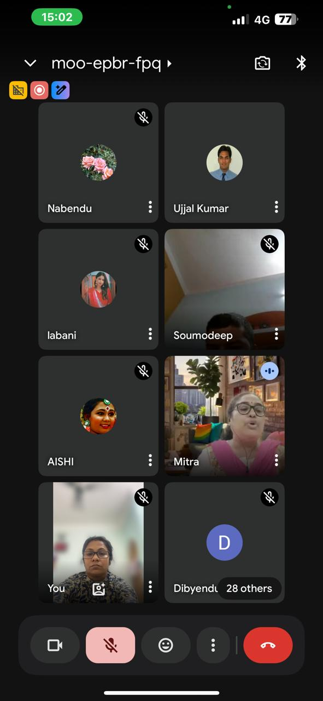
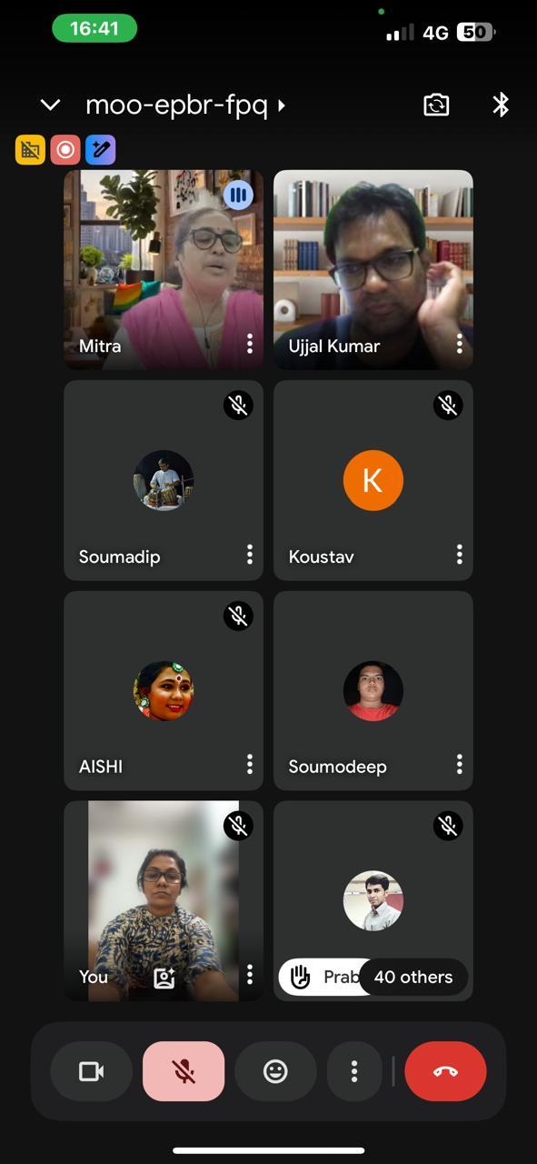
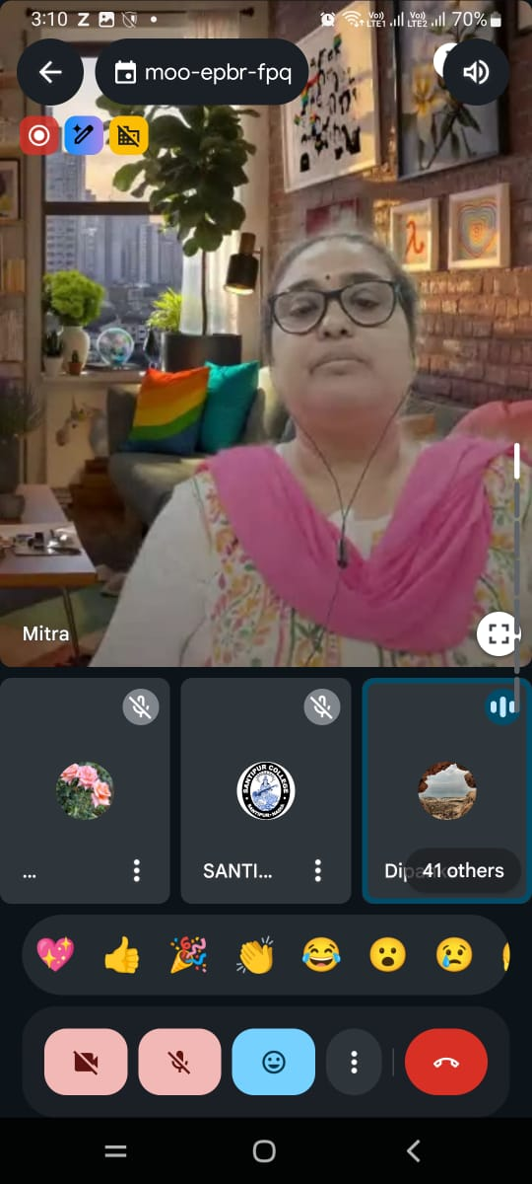
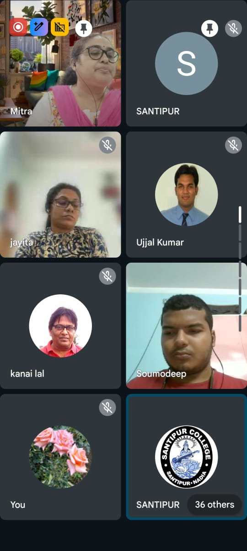

Slide 5
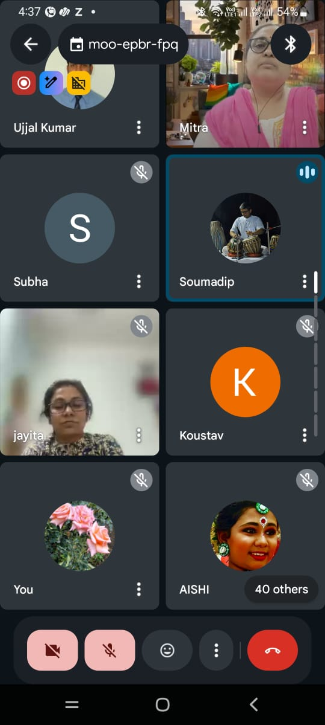
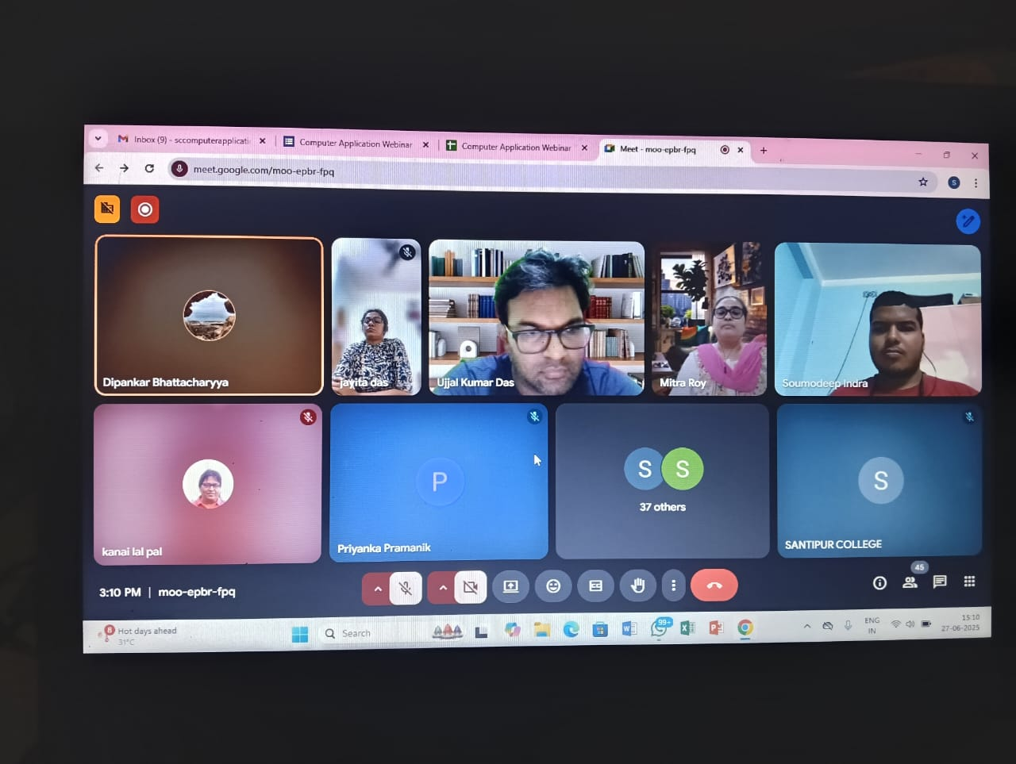
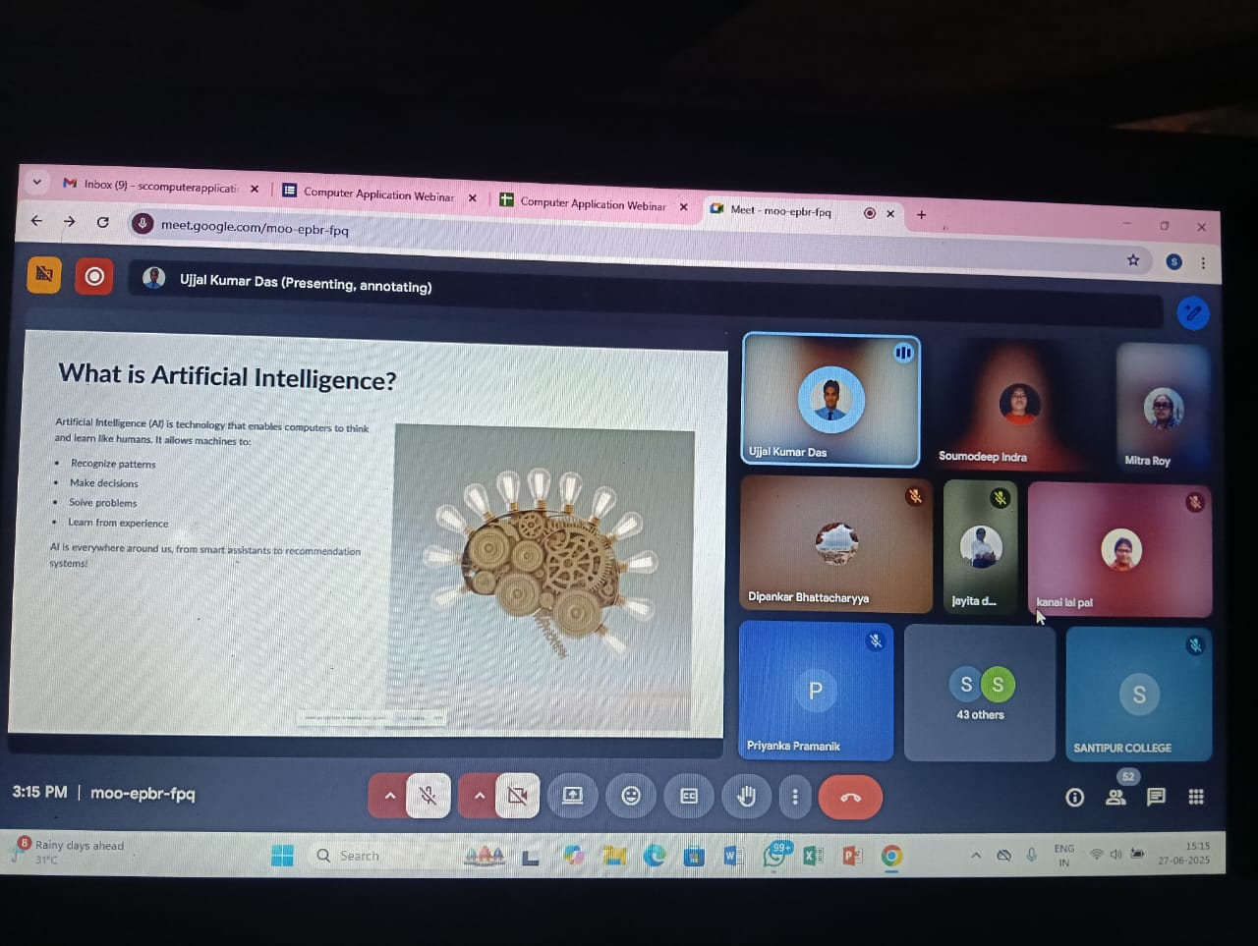
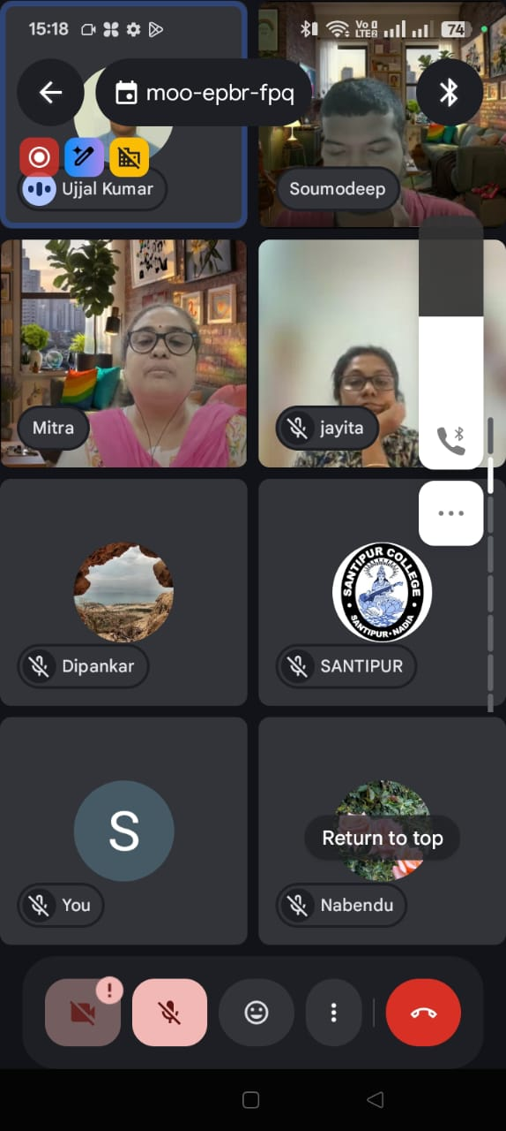
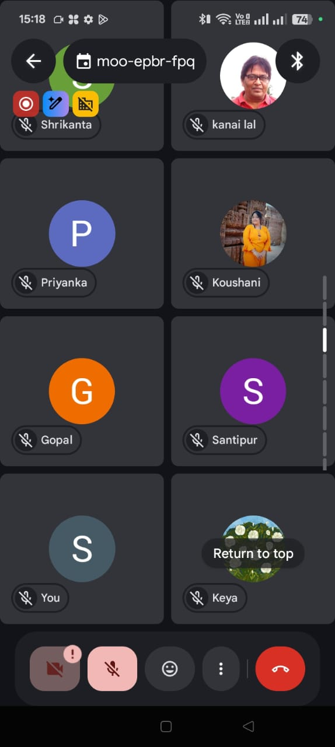
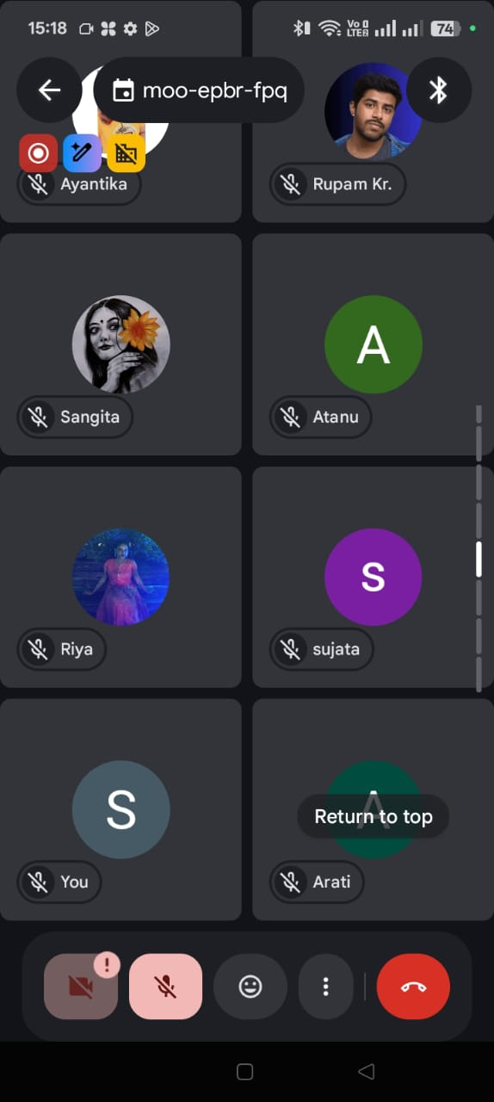
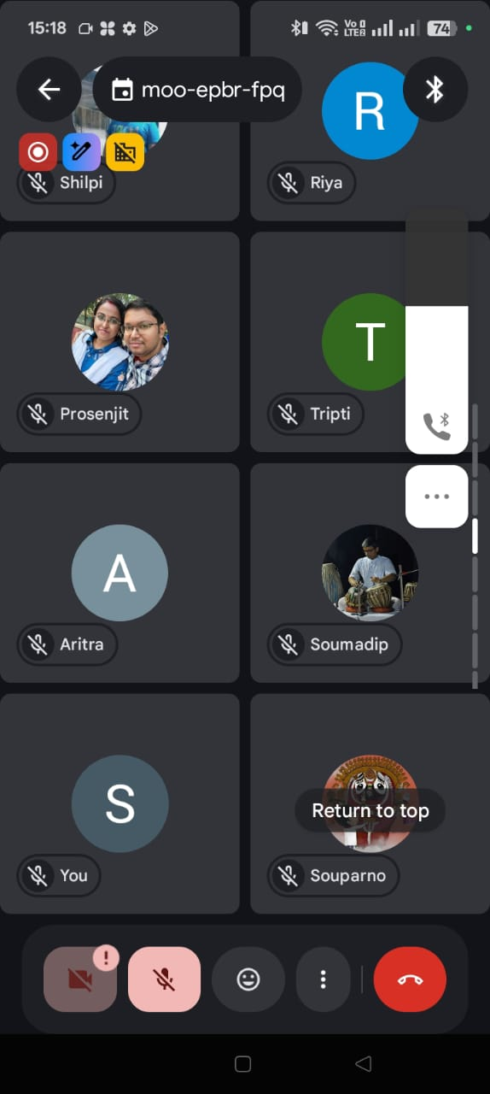
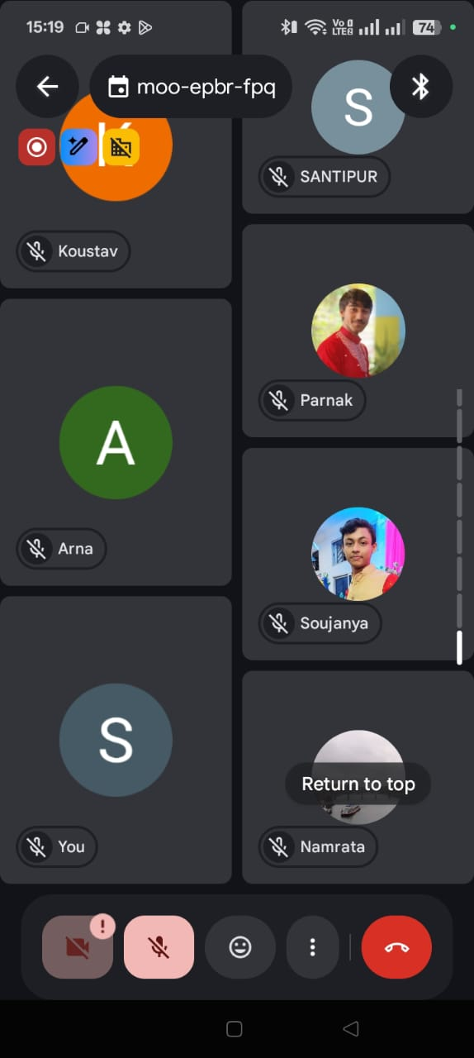

Slide 6
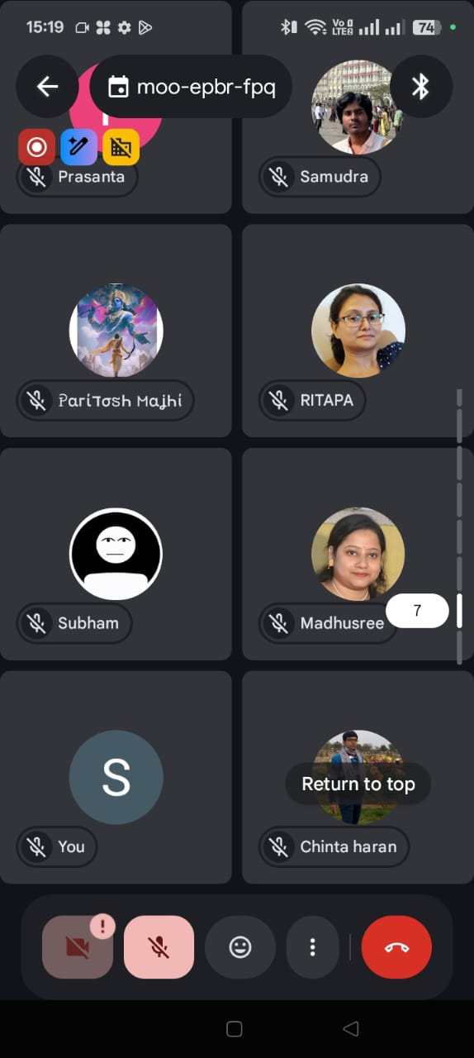
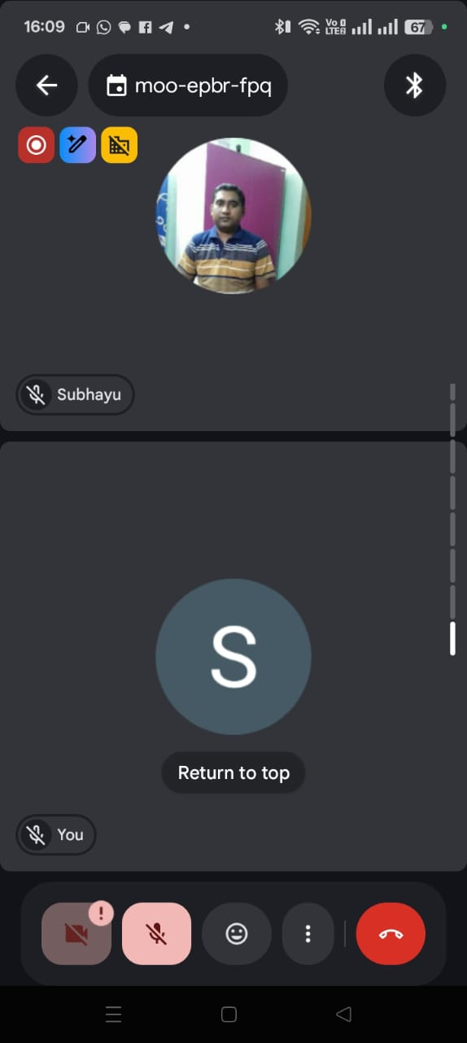
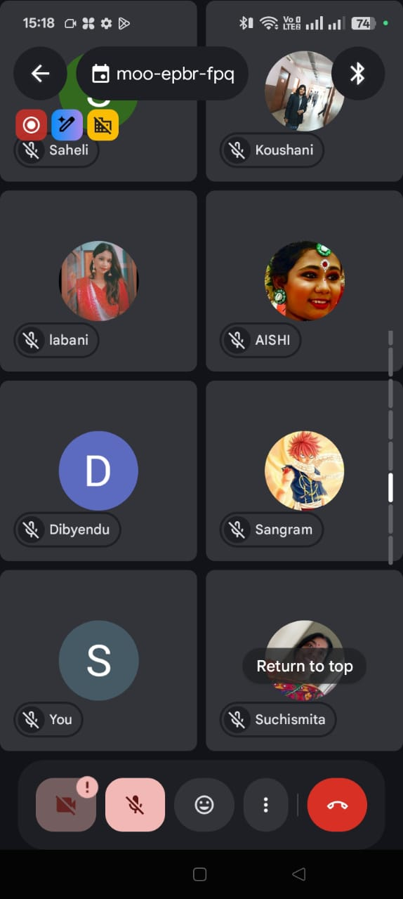
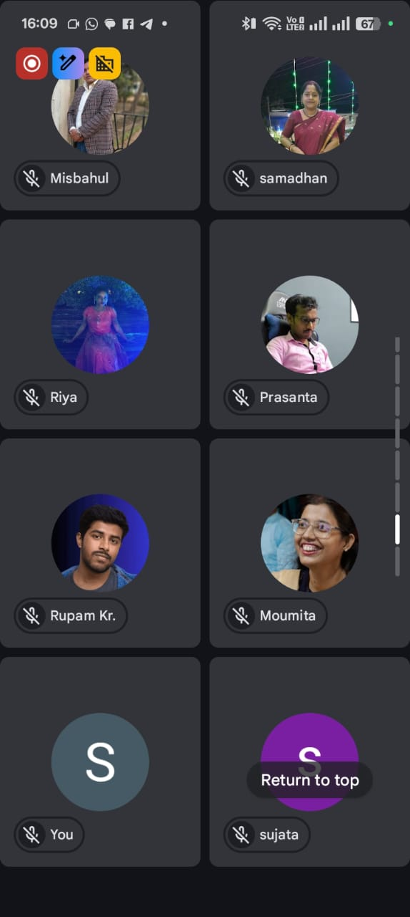
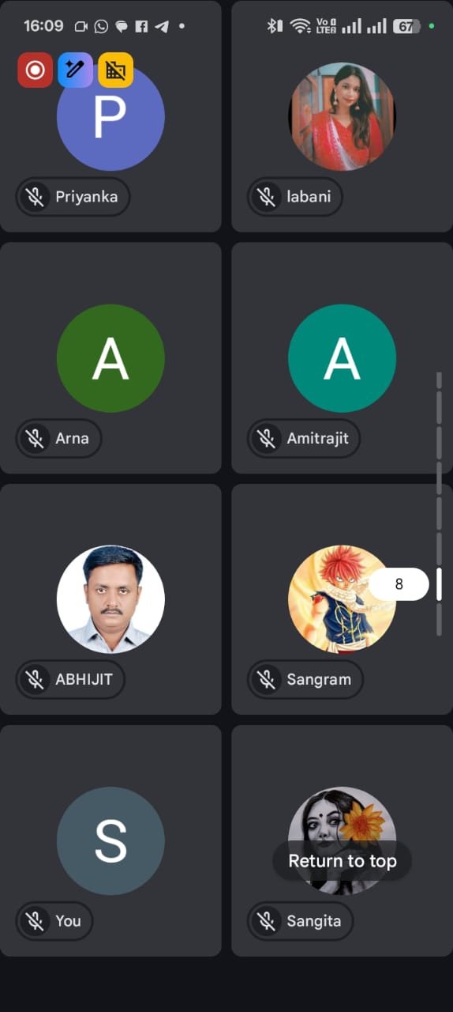
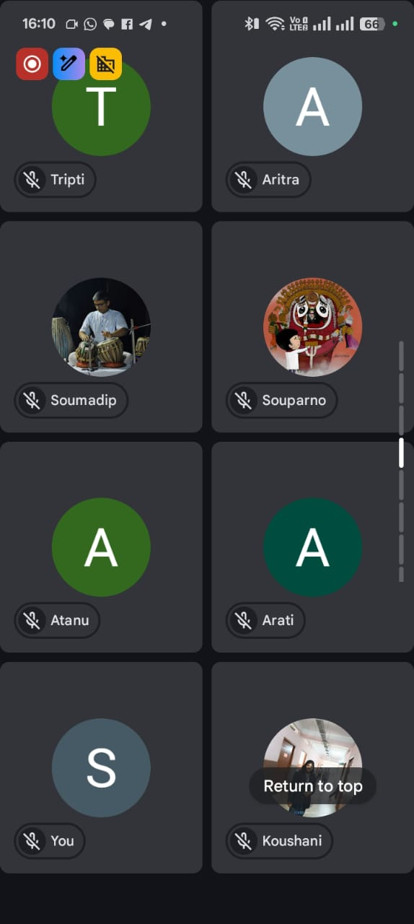
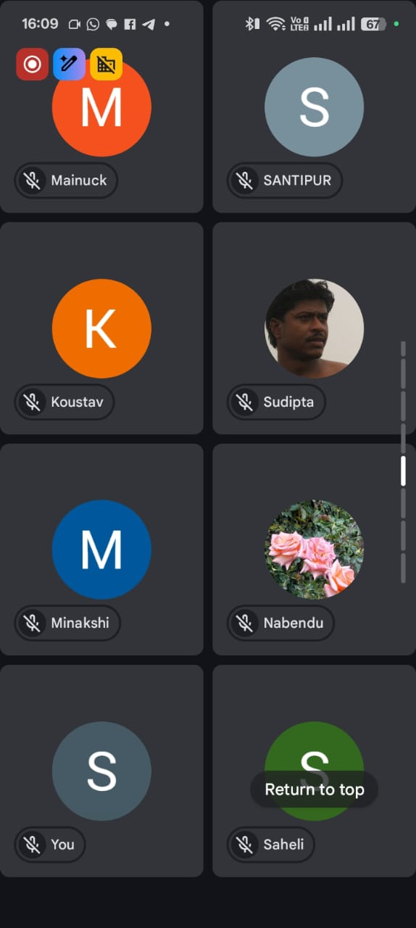
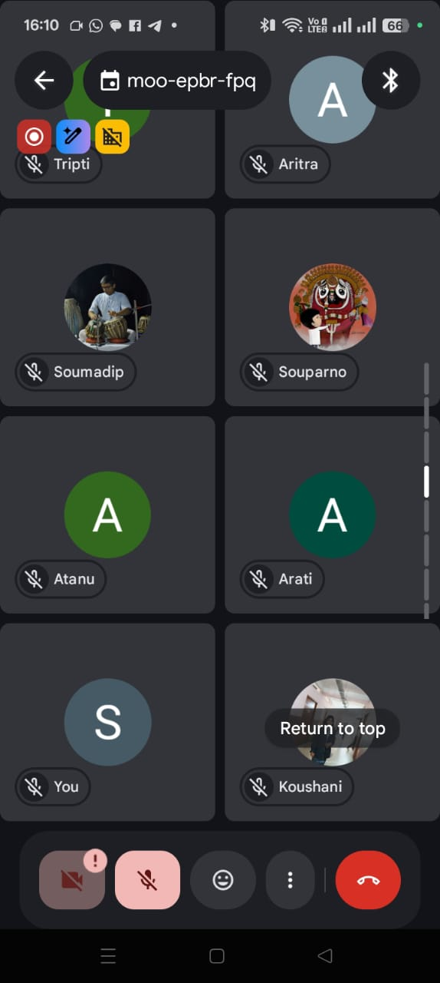

Slide 7
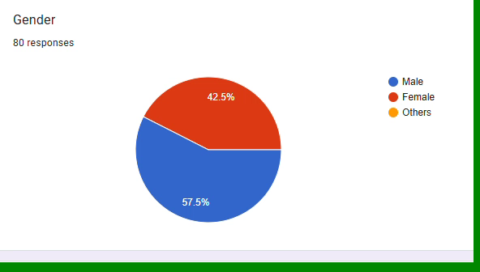
FEEDBACK FORM GRAPF -1 (GENDER)

Slide 8
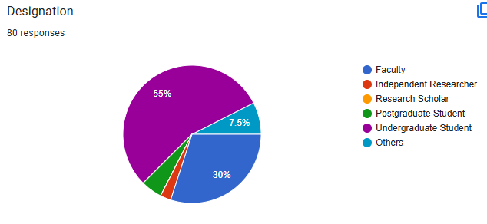
FEEDBACK FORM GRAPF -2 (DESIGNATION)

Slide 9
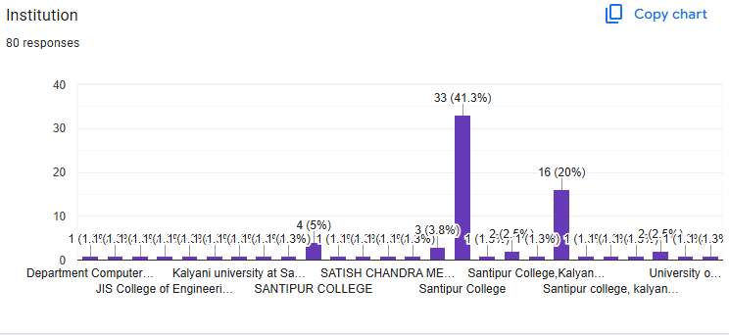
FEEDBACK FORM GRAPF – 3 (INSTITUTION)

Slide 10
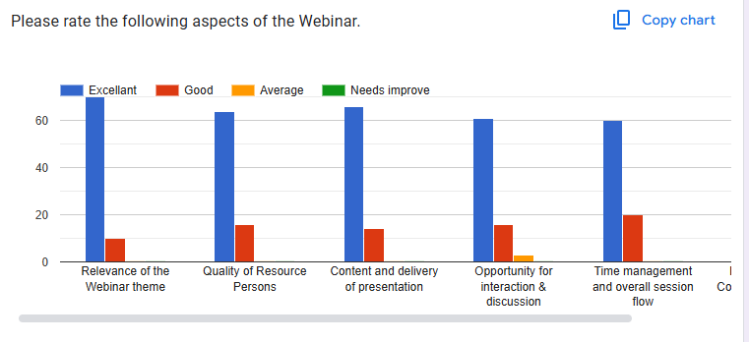
FEEDBACK FORM GRAPF – 4 (RATEING)

Slide 11
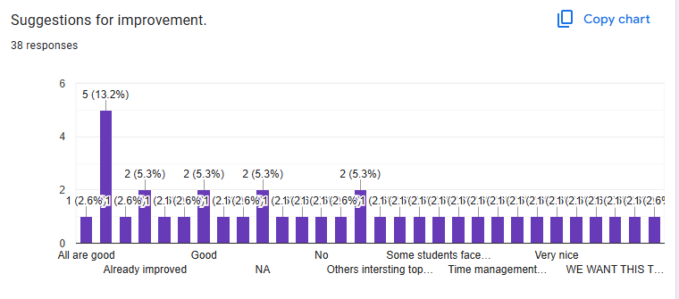
FEEDBACK FORM GRAPF – 5 (SUGGESSTION)

Slide 12
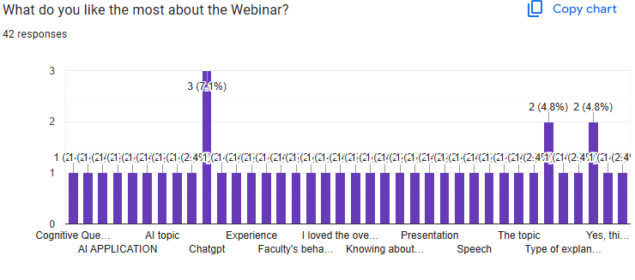
FEEDBACK FORM GRAPF – 6 (FEEDBACK )

Slide 13
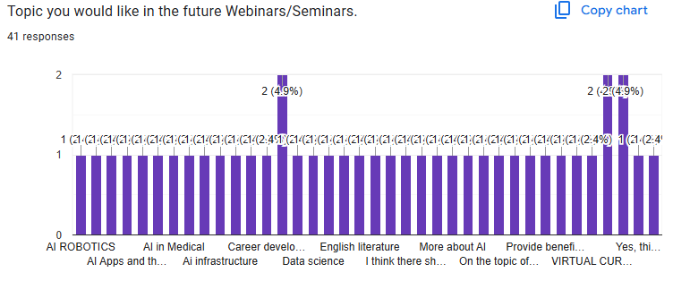
FEEDBACK FORM GRAPF – 7(TOPIC )

Slide 14
THANK U

